Slide 1
Word Embedding
(AI)

Slide 2
Table of contents
01
02
03
04
05
Tokenizer
Introduce Word Embedding
Word2Vec
fastText
Parameters of model

Slide 3
01
Tokenizer
(AI)

Slide 4
Tokenizer
Tokenization is a way of separating a piece of text into smaller units called tokens. Tokens can be either words, characters, or subwords. Tokenization can be broadly classified into 3 types – word, character, and subword (n-gram characters) tokenization.
Word-based
Character-based
Subword-based

Slide 5
Word-based
Word-based tokenization is the idea of splitting raw text into words, by splitting on the spaces or other specify rules like punctuation.
Learning | word-based | tokenization!
Learning | word | -based | tokenization | !

Slide 6
Word-based
Learning | word-based | tokenization!
250
731
1024

Slide 7
Word-based
the:1
of : 2
and: 3
to: 4
in: 5
was: 6
the: 7
is: 8
for: 9
as : 10
on: 11
with: 12
that: 13
dog: 14
dogs: 15
The word “dog” and “dogs” are very similarity meaning. But tokenizer represent two words with two ID, model will learning two words different meaning. This make lost a lot of information.

Slide 8
Word-based
the:1
of : 2
and: 3
to: 4
in: 5
was: 6
the: 7
is: 8
for: 9
as : 10
on: 11
with: 12
that: 13
…
hug: 10.0000
Let’s | gonna | play | game | FPS
250
UNK
731
1024
UNK
Same presentation

Slide 9
Character-based
Character-based tokenization is the idea of splitting raw text into individual characters.
Splitting on space
Let’s | do | tokenization!
Splitting on characters
L | e | t | ‘ | s | d | o | t | o | k | e | n | i | z | a | t | i | o | n | !

Slide 10
Character-based
a: 1
b: 2
c: 3
d: 4
e: 5
…
1: 27
2: 28
3: 29
…
!: 256
@: 257
the:1
of : 2
and: 3
to: 4
in: 5
was: 6
the: 7
is: 8
for: 9
as : 10
…
hug: 10.000
Character-based vocabulary
Word-based vocabulary

Slide 11
Character-based
Let’s | play | game | FPS
250
731
1024
UNK
L | e | t | ‘ | s | p | l | a | y | g | a | m | e | F | P | S
12 | 5 | 20 | 40 | 19 | 16 | 12 | 1 | 25 | 7 | 1 | 13 | 5 | 6 | 16 | 19

Slide 12
Subword-based
Word-based tokenization
Characters-based tokenization
Very large vocabulary
Large quality of out-of-vocabulary tokens
Loss of meaning across very similarity words
Very long sequences
Less meaningful individual tokens

Slide 13
Subword-based
Frequently used words should not be splitting into smaller subwords
Rare words should be decomposes into meaningful subwords
dog
dogs
d | o | g
dog | s

Slide 14
Subword-based
Rare words should be decomposes into meaningful subwords
tokenization
Token
Tokens
Tokenization
Tokenizing
token
##ization
Tokenization
Modernization
Immunization
Privatization

Slide 15
Subword-based
WordPiece
Unigram
Byte-Pair Encoding
BERT, DistilBERT
XLNet, T5, ALBERT
GPT-2, RoBERTa

Slide 16
Byte-Pair Encoding
Machine learning is a fascinating field .
Natural language processing helps computers understand human language .
Deep learning models , such as neural networks , have revolutionized AI .
machine | 1
learning | 2
is | 1
a | 1
fascinating | 1
field | 1
. | 3
natural | 1
language | 2
processing | 1
helps | 1
computers | 2
understand | 1
human | 1
deep | 1
, | 2
such | 1
as | 1
neural | 1
networks | 1
have | 1
revolutionized | 1
ai | 1
models | 1

Slide 17
Byte-Pair Encoding
machine | 1
learning | 2
learn | 2
learner | 2
revolutionized | 1
revolutionize | 1
revolutionary | 1
m | a | c | h | i | n | e
l | e | a | r | n | i | n | g
l | e | a | r | n
l | e | a | r | n | e | r
r | e | v | o | l | u | t | i | o | n | i | z | e | d
r | e | v | o | l | u | t | i | o | n | i | z | e
r | e | v | o | l | u | t | i | o | n | a | r | y

Slide 18
Byte-Pair Encoding
a | c | d
e | g | h
i | l | m
n | o | r
s | t | u
v | u | y
z
Vocab =

Slide 19
Byte-Pair Encoding
m | a | c | h | i | n | e
Pair Frequencies
m | a | 1
a | c | 1
…
a | r | 4
r | n | 3
…
r | y | 1
l | e | a | r | n | i | n | g
l | e | a | r | n
l | e | a | r | n | e | r
r | e | v | o | l | u | t | i | o | n | i | z | e | d
r | e | v | o | l | u | t | i | o | n | i | z | e
r | e | v | o | l | u | t | i | o | n | a | r | y

Slide 20
Byte-Pair Encoding
Merges
a | c | d
e | g | h
i | l | m
n | o | r
s | t | u
v | u | y
z | ar
a + r | ar
Vocab =

Slide 21
Byte-Pair Encoding
m | a | c | h | i | n | e
Pair Frequencies
m | a | 1
a | c | 1
…
l | e | 3
e | ar | 3
…
ar | y | 1
l | e | ar |  | n | i | n | g
l | e | ar |  | n
l | e | ar |  | n | e | r
r | e | v | o | l | u | t | i | o | n | i | z | e | d
r | e | v | o | l | u | t | i | o | n | i | z | e
r | e | v | o | l | u | t | i | o | n | ar |  | y

Slide 22
Byte-Pair Encoding
Merges
a | c | d
e | g | h
i | l | m
n | o | r
s | t | u
v | u | y
z | ar | le
a + r | ar
l + e | le
Vocab =

Slide 23
Byte-Pair Encoding
m | a | c | h | i | n | e
Pair Frequencies
m | a | 1
a | c | 1
…
le | ar | 3
ar | n | 3
…
ar | y | 1
le |  | ar |  | n | i | n | g
le |  | ar |  | n
le |  | ar |  | n | e | r
r | e | v | o | l | u | t | i | o | n | i | z | e | d
r | e | v | o | l | u | t | i | o | n | i | z | e
r | e | v | o | l | u | t | i | o | n | ar |  | y

Slide 24
Byte-Pair Encoding
a | c | d
e | g | h
i | l | m
n | o | r
s | t | u
v | u | y
z | ar | le
lear
Merges
a + r | ar
l + e | le
le + ar | lear
Vocab =

Slide 25
Byte-Pair Encoding
Merges
Vocab
a + r = ar | revolut + i = revoluti
l + e = le | revoluti + o = revolutio
le + ar = learn | revolutio + n = revolution
r + e = re | i + n = in
re + v = rev | m + a = ma
rev + o = revo | ma + c = mac
revo + l = revol | mac + h = mach
revol + u = revolu | mach + in = machin
revolu + t = revolut | lear + n = learn
a | c | d | e | revoluti | machin
g | h | i | l | revoltio | in
m | n | o | r | revolution
s | t | u | v | lear
u | y | z | ar | ma
le | learn | re | rev | mac
revo | revol | revolu | revolut | mach

Slide 26
Byte-Pair Encoding
Merges
a + r = ar | revolut + i = revoluti
l + e = le | revoluti + o = revolutio
le + ar = lear | revolutio + n = revolution
r + e = re | i + n = in
re + v = rev | m + a = ma
rev + o = revo | ma + c = mac
revo + l = revol | mac + h = mach
revol + u = revolu | mach + in = machin
revolu + t = revolut | lear + n = learn
learns
learn
s

Slide 27
WordPiece
Machine learning is a fascinating field .
Natural language processing helps computers understand human language .
Deep learning models , such as neural networks , have revolutionized AI .
machine | 1
learning | 2
is | 1
a | 1
fascinating | 1
field | 1
. | 3
natural | 1
language | 2
processing | 1
helps | 1
computers | 2
understand | 1
human | 1
deep | 1
, | 2
such | 1
as | 1
neural | 1
networks | 1
have | 1
revolutionized | 1
ai | 1
models | 1

Slide 28
WordPiece
machine | 1
learning | 2
learn | 2
learner | 2
revolutionized | 1
revolutionize | 1
revolutionary | 1
m | ##a | ##c | ##h | ##i | ##n | ##e
l | ##e | ##a | ##r | ##n | ##i | ##n | ##g
l | ##e | ##a | ##r | ##n
l | ##e | ##a | ##r | ##n | ##e | ##r
r | ##e | ##v | ##o | ##l | ##u | ##t | ##i | ##o | ##n | ##i | ##z | ##e | ##d
r | ##e | ##v | ##o | ##l | ##u | ##t | ##i | ##o | ##n | ##i | ##z | ##e
r | ##e | ##v | ##o | ##l | ##u | ##t | ##i | ##o | ##n | ##a | ##r | ##y

Slide 29
WordPiece
##a | ##c | ##d
##e | ##g | ##h
##i | l | m
##n | ##o | r
##s | ##t | ##u
##v | ##u | ##y
##z | ##r
Vocab =

Slide 30
WordPiece
Frequency of pair
Pair Score =
Frequency of first element * Frequency of second element

Slide 31
WordPiece
Pair Score
m | ##a | ##c | ##h | ##i | ##n | ##e
m | ##a | 0.2
##a | ##c | 0.2
##c | ##h | 1.0
…
##o | ##n | 0.0625
…
##r | ##y | 0.125
l | ##e | ##a | ##r | ##n | ##i | ##n | ##g
l | ##e | ##a | ##r | ##n
l | ##e | ##a | ##r | ##n | ##e | ##r
r | ##e | ##v | ##o | ##l | ##u | ##t | ##i | ##o | ##n | ##i | ##z | ##e | ##d
r | ##e | ##v | ##o | ##l | ##u | ##t | ##i | ##o | ##n | ##i | ##z | ##e
r | ##e | ##v | ##o | ##l | ##u | ##t | ##i | ##o | ##n | ##a | ##r | ##y

Slide 32
WordPiece
Merges
a | c | d
e | g | h
i | l | m
n | o | r
s | t | u
v | u | y
z | ##ch
##c + ##h | ##ch
Vocab =

Slide 33
WordPiece
Pair Score
m | ##a | ##ch |  | ##i | ##n | ##e
m | ##a | 0.2
##a | ##ch | 0.2
##u | ##t | 0.333
##t | ##i | 0.143
…
##r | ##y | 0.125
l | ##e | ##a | ##r | ##n | ##i | ##n | ##g
l | ##e | ##a | ##r | ##n
l | ##e | ##a | ##r | ##n | ##e | ##r
r | ##e | ##v | ##o | ##l | ##u | ##t | ##i | ##o | ##n | ##i | ##z | ##e | ##d
r | ##e | ##v | ##o | ##l | ##u | ##t | ##i | ##o | ##n | ##i | ##z | ##e
r | ##e | ##v | ##o | ##l | ##u | ##t | ##i | ##o | ##n | ##a | ##r | ##y

Slide 34
WordPiece
Merges
a | c | d
e | g | h
i | l | m
n | o | r
s | t | u
v | u | y
z | ##ch | ##ut
##c + ##h | ##ch
##u + ##t | ##ut
Vocab =

Slide 35
WordPiece
Pair Score
m | ##a | ##ch |  | ##i | ##n | ##e
m | ##a | 0.2
##a | ##ch | 0.2
r | ##e | 0.0375
##e | ##v | 0.1
…
##r | ##y | 0.125
l | ##e | ##a | ##r | ##n | ##i | ##n | ##g
l | ##e | ##a | ##r | ##n
l | ##e | ##a | ##r | ##n | ##e | ##r
r | ##e | ##v | ##o | ##l | ##ut |  | ##i | ##o | ##n | ##i | ##z | ##e | ##d
r | ##e | ##v | ##o | ##l | ##ut |  | ##i | ##o | ##n | ##i | ##z | ##e
r | ##e | ##v | ##o | ##l | ##ut |  | ##i | ##o | ##n | ##a | ##r | ##y

Slide 36
WordPiece
a | c | d
e | g | h
i | l | m
n | o | r
s | t | u
v | u | y
z | ##ch | ##ut
ma
Merges
##c + ##h | ##ch
##u + ##t | ##ut
m + ##a | ma
Vocab =

Slide 37
WordPiece
Merges
Vocab
##c + ##h = ##ch | ##voluti + ##o = ##volutio
##u + ##t = ##ut | ##volutio + ##n = ##volution
m + ##a = ma | ##i + ##z = ##iz
ma + ##ch = mach | machi + ##n = machin
##v + ##o = ##vo | ##i + ##n = ##in
##vo + ##l = ##vol | ##in + ##g = ##ing
##vol + ##ut = ##volut | #volution + #iz = ##volutioniz
mach + ##i = machi | #volution + #a = ##volutiona
##volut + ##i = ##voluti | #volutiona + #r = ##volutionar
##a | ##c | ##d | ##e | ##voluti | machin
##g | ##h | ##i | l | ##iz | ##n
m | ##n | ##o | r | ##ing | ##volutio
##s | ##t | ##u | ##v | ##volution
##u | ##y | ##z | ##r | ##volutioniz
##ch | ##ut | ##vo | ##volut | ##volutiona
ma | mach | ##vol | machi | ##volutionar

Slide 38
WordPiece
machin
Vocab
##a | ##c | ##d | ##e | ##voluti | machin
##g | ##h | ##i | l | ##iz | ##n
m | ##n | ##o | r | ##ing | ##volutio
##s | ##t | ##u | ##v | ##volution
##u | ##y | ##z | ##r | ##volutioniz
##ch | ##ut | ##vo | ##volut | ##volutiona
ma | mach | ##vol | machi | ##volutionar
machine
##e
UNK
##o
convolution
##n
##volution

Slide 39
02
Introduce Word Embedding
(AI)

Slide 40
What is Word Embedding
Word Embeddings are a method to translate a string of text into an N-dimensional vector of real numbers. Words appearing within similar context possess similar meaning.
Why need to translate a string of text into a N-dimensional vector of real numbers ?
?
Today is so hot
Học sinh học môn sinh học
Học sinh đến trường
Môn sinh học là một môn khoa học tự nhiên
Hoa lá sinh sôi nảy nở

Slide 41
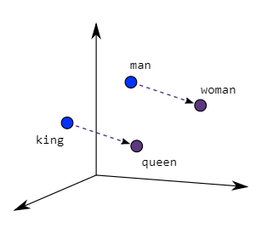
Similarity
Define vector space whole similar word are close with each other
king - man + women = queen

Slide 42
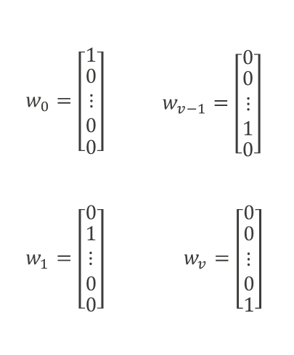
One hot encoding
Example:Vocabulary V have v=|V| is number of words in vocab
Issues:
•Long sparse vector
•No notion of similarity
•No notion of meaning

Slide 43
Word Embedding
Word | “Royalty” Feature | “Masculinity” Feature
Queen | 0.958123 | 0.03591294
King | 0.94981289 | 0.92959219
Man | 0.051231 | 0.9592109321
Woman | 0.0912987 | 0.04912983189
In this example, we could identify the concept of Masculinity by the vector <0,1> and Royalty by <1,0>.

Slide 44
Word Embedding
Word | Feature 1 | Feature 2 | Feature 3
Queen | 0.854712 | 0.32145 | 0.123512
King | 0.9521 | 0.23151 | 0.721385
Man | 0.12351 | 0.067231 | 0.85921
Woman | 0.23131 | 0.123151 | 0.011249
However, in real world examples, it is rarely this simple. In general, we do not know exactly what each of the N features mean

Slide 45
03
Word2Vec
(AI)

Slide 46
What is Word2Vec
Word2Vec is a collection of algorithms developed by Google to generate word embeddings based on word context. Both algorithms utilize a neural network to optimize the embeddings. The first model type is called a Continuous Bag of Words (CBOW), and predicts a word given the words surrounding it. The second model type is called Skip-Gram and does the opposite; given a word, predict the words surrounding it.
(a) Continuous Bag of Words (CBOW)
Predict target word from context words.
(b) Skip-Gram
Predict context words from target word

Slide 47
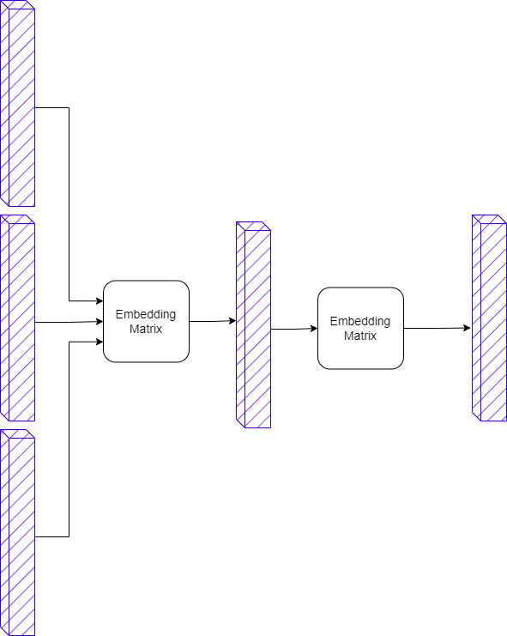
CBOW
1
0
0000
Em yêu trường em
Tôi thích phở
{
'em',
'phở',
'thích',
'trường',
'tôi',
'yêu',
}ở'}
00
0
100
0.09
0.05
0.2
0.01
0.01
0.64
10
0
000

Slide 48
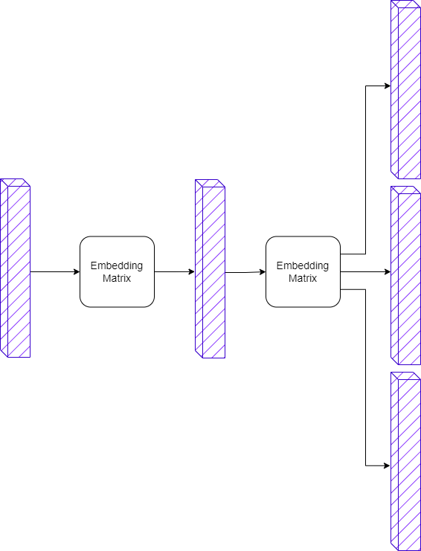
Skip-Gram
0.7
0.02
0.04
0.09
0.1
0.05
Em yêu trường em
Tôi thích phở
{
'em',
'phở',
'thích',
'trường',
'tôi',
'yêu',
}ở'}
00
0001
0.05
0.03
0.02
0.69
0.11
0.1
0.51
0.02
0.06
0.2
0.2
0.01

Slide 49
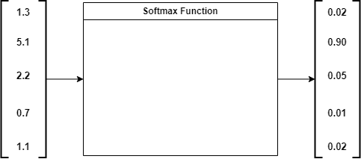

Softmax
$$s\left(x_{i}\right)=\frac{e^{x_{i}}}{\sum_{j=1}^{n}{e^{x_{j}}}}$$

Slide 50
Limitations of Word2Vec
(a) Out of Vocabulary (OOV) Words
In Word2Vec, an embedding is created for each word. As such, it can’t handle any words it has not encountered during its training.
For example, words such as “tensor” and “flow” are present in the vocabulary of Word2Vec. But if you try to get embedding for the compound word “tensorflow”, you will get an out of vocabulary error.
(b) Morphology
For words with same radicals such as “eat” and “eaten”, Word2Vec doesn’t do any parameter sharing. Each word is learned uniquely based on the context it appears in. Thus, there is scope for utilizing the internal structure of the word to make the process more efficient.

Slide 51
04
fastText
(AI)

Slide 52







Sub-word generation
Take a word and add angular brackets to denote the beginning and end of a word
Then, we generate character n-grams of length n. Example: Word is eating and n-grams is 3

Slide 53
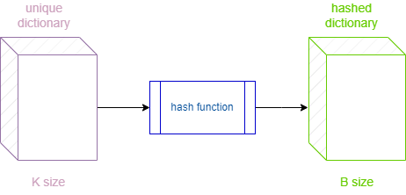
Sub-word generation
Since there can be huge number of unique n-grams hashing to bound the memory requirements.
Instead of learning an embedding for each unique n-gram, model will learn total B embeddings where B denotes the bucket size

Slide 54

Sub-word generation
Each character n-gram is hashed to an integer between 1 to B.
It helps control the vocabulary size

Slide 55
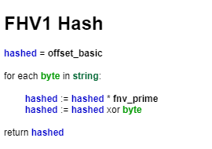
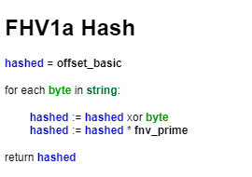
Fowler-Noll-Vo Hashing

Slide 56
05
Parameters of model
(AI)

Slide 57
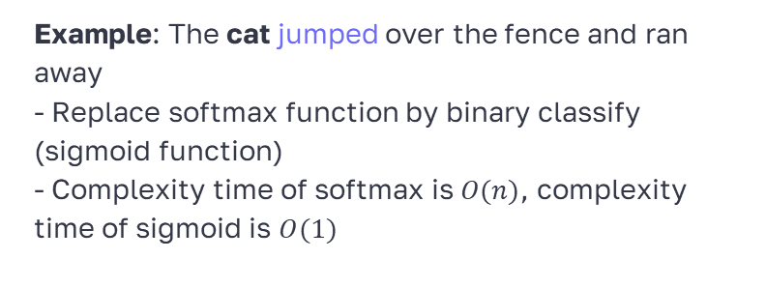
Negative Sampling
Maximizing the similarity of the words in the same context
Minimizing the similarity of the words when they occur in different contexts
Instead of computing probabilities for all words in entire corpus, Negative sampling just consider small subset of words (negative examples) for each training example.
cat | jumped
cat | Tennis
cat | Nurse
cat | Sea
cat | Apple
cat | Carrot
Example: The cat jumped over the fence and ran away
- Replace softmax function by binary classify (sigmoid function)
- Complexity time of softmax is $O(n)$, complexity time of sigmoid is $O(1)$

Slide 58
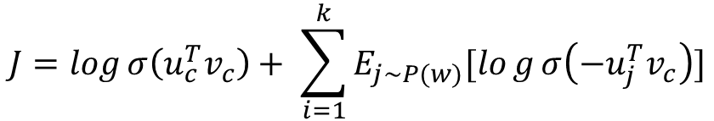
Negative Sampling
$$J=\log{σ\left(u_{c}^{T}v_{c}\right)+ \sum_{i=1}^{k}{E_{j\sim P(w)}[log{σ\left(−u_{j}^{T}v_{c}\right)}]}}$$

Slide 59
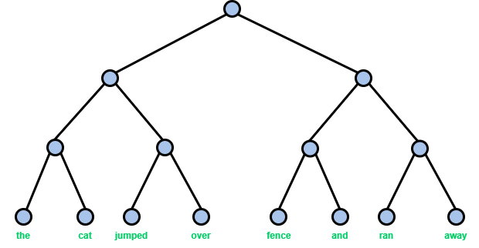
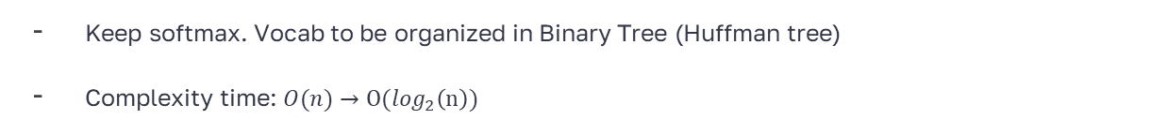
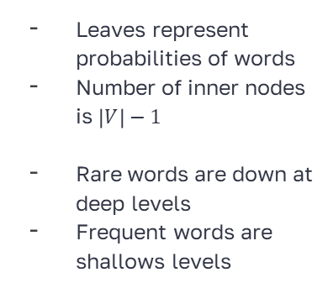
Hierarchical Softmax
Keep softmax. Vocab to be organized in Binary Tree (Huffman tree)
Complexity time: $O(n)→O(\log_{2}\left(n\right))$
Leaves represent probabilities of words
Number of inner nodes is $\left|V\right|−1$
Rare words are down at deep levels
Frequent words are shallows levels

Slide 60
Hierarchical Softmax

Slide 61
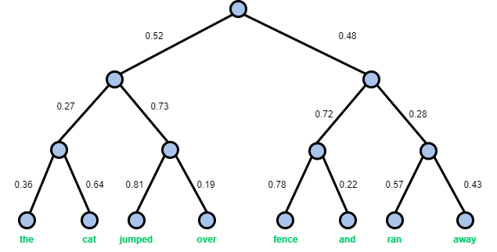
Hierarchical Softmax
the | 0.050544
cat | 0.089856
jumped | 0.307476
over | 0.072124
fence | 0.269568
and | 0.076032
ran | 0.076608
away | 0.057792

Slide 62
06
Experiment
(AI)

Slide 63
Thanks!
Any questions?
youremail@freepik.com
+91 620 421 838
yourwebpage.com
Please, keep this slide as attribution

Slide 64
Alternative resources
Here’s an assortment of alternative resources whose style fits that of this template:
Chat bot composition with human characters using gadgets and flying robots spreading chat bubbles flat images vector illustration

Slide 65
Resources
Did you like the resources in this template? Get them for free on our other websites:
Vectors
Chat bot composition with human characters using gadgets and flying robots spreading chat bubbles flat images vector illustration
Chat bot composition with collage of flat chat bubbles character of robot and guy at computer vector illustration
Free vector white wall texture

